Slide 1
CLAMPING AND UNCLAMPING IN OPEN AORTIC REPAIR – ABDOMINAL AORTIC ANEURYSM
DR. VIJAY KUMAR S

Slide 2
INTRODUCTION
The time of temporary cross-clamping of the aorta and consecutively removing the clamp and restoring the blood flow to the part of the body distal to the clamp site are among the most critical steps for the anesthesiologist during surgery involving the aorta.
Open surgical procedures of the thoraco-abdominal aorta carry the highest mortality rate among elective procedures, with a reported overall 30-day mortality ranging from 8% to 35%.
Cox GS, O'Hara PJ, Hertzer NR, et al. Thoracoabdominal aneurysm repair: a representative experience. J Vasc Surg 1992; 15(5):780e7. discussion 7e8.

Slide 3
OPEN AORTIC REPAIR
INDICATIONS
Unfavorable anatomy for EVAR or FEVAR.
Need to preserve patency of IMA (hypertrophied vessel, occluded SMA/CA or bilateral hypogastric arteries, or prior hemicolectomy)
Renovascular variants (horseshoe kidney, renal ectopia, multiple small renal arteries arising across the abdominal aorta, etc.)
Inability to preserve at least one hypogastric with EVAR.
Symptomatic or ruptured juxtarenal AAA (inability to await construction of a custom- built FEVAR device).
Any prohibitive access issues such as excessive aortoiliac tortuosity and/or small access vessels and/or iliofemoral occlusive disease not amenable to staged optimization.
Strong patient preference, with no prohibitive risk factors for OAR

Slide 4
INDICATIONS Cont…
Prolonged life expectancy (younger than 65 years)
Known connective tissue disorder or genetic vascular syndrome
Likely non-compliance with required follow-up requirements of EVAR, in the absence of prohibitive risk factors for OAR
Open conversion:
Infection of prior EVAR/FEVAR
Failure after prior EVAR, F/B-EVAR not amenable to endovascular rescue. Usually due to type 1 or 3 endoleak, device migration.
Prior EVAR with type 2 endoleak and sac growth, refractory to endovascular treatment.
Failure after prior OAR, not amenable to endovascular rescue
Inflammatory AAA
Mycotic AAA
Infection or aortoenteric fistula

Slide 5
PREOPERATIVE ASSESSMENT AND PLANNING
Physiologic derangements that occur as a result of the hemodynamic stress of aortic cross-clamping, a detailed understanding of the patient’s cardiac, pulmonary, and renal function is necessary to determine who is a candidate for OAR.
The modified frailty index (mFI) score is a commonly used measure derived from comorbidity and preoperative functional status data that can be used as a predictive tool to aid in surgical planning of patients undergoing elective AAA repair.

Slide 6
Pre op planning and assessment
CTA/MRA as the optimal choice for comprehensive assessment of vascular anatomy including
Geometric Measures,
Angulation
Tortuosity
Underlying Occlusive Disease
Extent Of Wall Calcification
Mural Thrombus And Shaggy Aorta
Which Are Crucial For Planning The Best Approach Including Preoperative Choice Of Clamp Site

Slide 7
Cont….
Hertzer et al. in their series from Cleveland Clinic revealed that in patients with AAAs undergoing coronary angiography, 6% had normal coronaries, 29% had mild to moderate coronary artery disease (CAD), 31% had correctable CAD, 12–15% had severe correctable CAD, and 5% had inoperable CAD.
In their series, 44% with clinical indicators of CAD and 15% without clinical indicators had angiographic demonstration of severe CAD.

Slide 8
OPERATIVE TECHNIQUE
There are two widely practiced approaches to open aneurysm repair
Transperitoneal
Retroperitoneal
Laproscopic
Pararenal

Slide 9
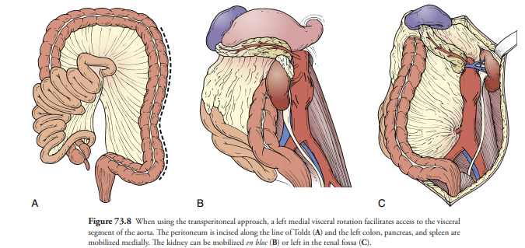
TRANSPERITONEAL APPROACH

Slide 10
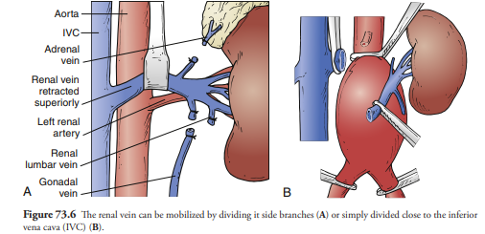
Cont….

Slide 11
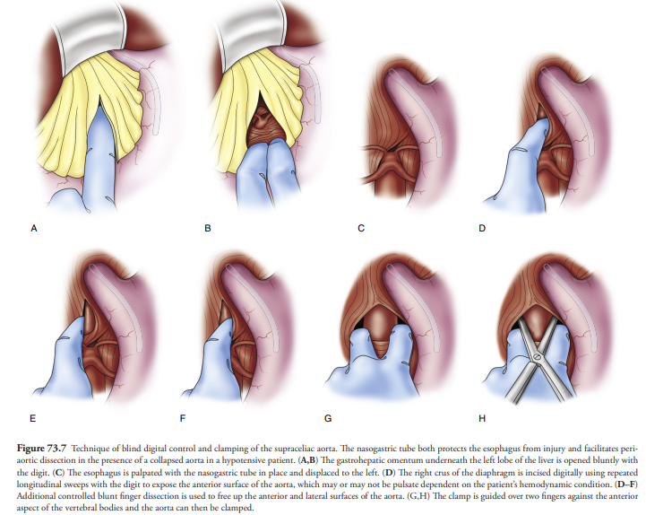
SUPRACELIAC CONTROL

Slide 12
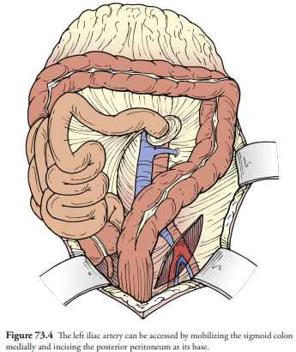
CONT….

Slide 13
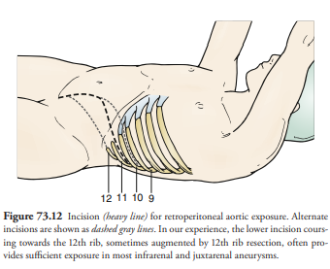
RETROPERITONEAL APPROACH

Slide 14
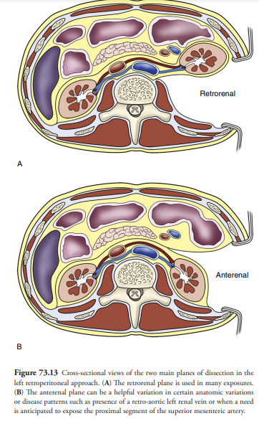
Cont…

Slide 15
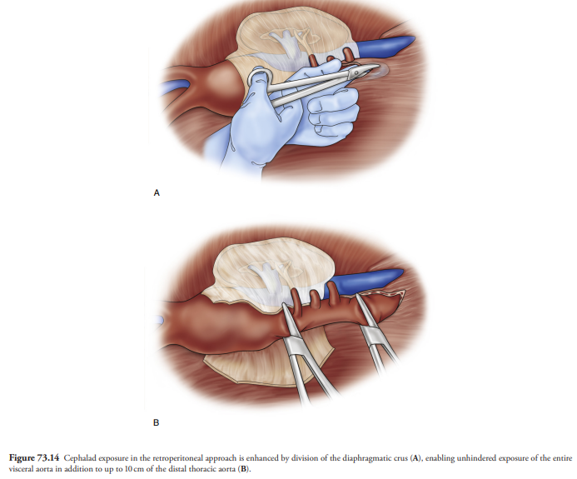
Cont…..

Slide 16
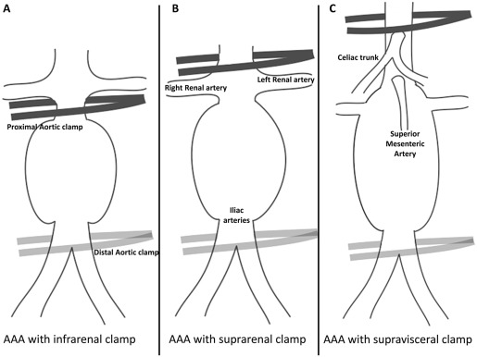
AORTIC CLAMPING

Slide 17
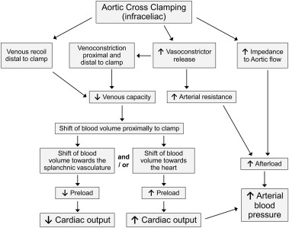
Hemodynamic changes – Aortic cross clamping

Slide 18
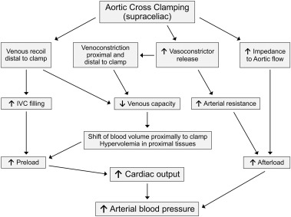
Cont…..

Slide 19
Cont…
If the cross-clamp is applied to the infraceliac aorta, the data on changes in the preload and cardiac output are inconclusive. Stokland performed clamping of the abdominal aorta and selective clamping of the lower IVC and selective veins, and demonstrated that during occlusion of the abdominal aorta, the blood flow shifts from the nonsplanchnic venous system into the IVC, leading to an increase in the preload and the blood pressure.
Stokland O, Miller MM, Ilebekk A, et al. Mechanism of hemodynamic responses to occlusion of the descending thoracic aorta. Am J Physiol 1980;238(4):H423e9.

Slide 20
Cont…..
Gelman et al. found similar shifts in blood volume during clamping of the aorta at the level of the diaphragm. In their canine model, the activity of the Tc99m-labeled plasma albumin increased by 38%inareas proximal to the clamp such as the brain, heart, deltoid muscle, and lungs. This increase in blood volume was however not observed during suprarenal aortic clamping.
They concluded that the blood flow could shift from capacitance vessels distal tothe occlusion toward areas proximal to the cross-clamp.
Gelman S, Khazaeli MB, Orr R, et al. Blood volume redistribution during cross-clamping of the descending aorta. Anesth Analgesia 1994;78(2):219e24.

Slide 21
Cont…..
Fayad A, Yang H, Nathan H, Bryson GL, Cina CS. Acute diastolic dysfunction in thoracoabdominal aortic aneurysm surgery. Can J Anaesth. 2006;53:168–173. doi: 10.1007/BF03021823.
Acute diastolic dysfunction after high aortic clamping in six of nine patients with normal E/A ratios before clamping in thoracoabdominal surgery and three of those patients developed myocardial infarction.The level of aortic cross clamp again has an influence on diastolic dysfunction and its effect on outcome.

Slide 22
Cont……
Meierhenrich R, Gauss A, Anhaeupl T, Schütz W. Analysis of diastolic function in patients undergoing aortic aneurysm repair and impact on hemodynamic response to aortic cross-clamping. J Cardiothorac Vasc Anesth. 2005;19:165–172. doi: 10.1053/j.jvca.2005.01.025.
reported a 50% baseline incidence of diastolic dysfunction in patients undergoing AAA repair. Aortic cross-clamping was not associated with impairment of diastolic dysfunction and the hemodynamic changes were similar in patients with or without diastolic dysfunction

Slide 23
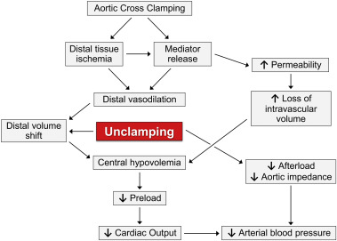
Hemodynamic changes - Unclamping
Increase preload
Maintain good urine output
ABG
Use of Bicarbonate
Avoid antihypertensive infusion
Increase the SBP by 15-20% prior to clamp release
Vasopressor drugs and infusions to be kept ready
Heparin Reversal

Slide 24
Cont…
Ueda N, Dohi S, Akamatsu S, et al. Pulmonary arterial and right ventricular responses to prophylactic albumin administration before aortic unclamping during abdominal aortic aneurysmectomy. Anesth Analg. 1998;87:1020–1026.
Volume loading with 10 ml/kg of albumin before unclamping during AAA repair and have shown that albumin did not prevent systemic hypotension, but significantly increased pulmonary artery pressure and right ventricular afterload causing RV dilatation. Cautious fluid administration is recommended in patients with cardiac dysfunction.
Bitoh H, Nakanishi K, Takeda S, Kim C, Mori M, Sakamoto A. Repair of an infrarenal abdominal aortic aneurysm is associated with persistent left ventricular diastolic dysfunction. J Nippon Med Sch. 2007;74:393–401. doi: 10.1272/jnms.74.393
Left ventricular diastolic dysfunction, measured using the mitral annular velocity by tissue Doppler method, after unclamping in eight patients undergoing infrarenal AAA repair and the dysfunction persisted until the end of the surgery. Pulmonary edema occurred in two of their patients with the lowest tissue Doppler mitral annular velocity. Gradual release of the clamp is recommended to prevent adverse events.

Slide 25
Cont…
Johnston WE, Balestrieri FJ, Plonk G, D’Souza V, Howard G. The influence of periaortic collateral vessels on the intraoperative hemodynamic effects of acute aortic occlusion in patients with aorto-occlusive disease or abdominal aortic aneurysms. Anesthesiology. 1987;66:386–389. doi: 10.1097/00000542-198703000-00020
Comparsion of hemodynamics in patients with aneurysmal and aorto-occlusive disease and found that patients in the aorto-occlusive group had an increased stroke volume and less of an increase in SVR during aortic cross-clamping compared to patients with aneurysmal disease. These findings could be explained by persistent para-aortic collateral circulation to the lower extremities in chronic occlusive disease and minimal metabolite and lactate accumulation

Slide 26
Cont….
In a rat model, 60 min of intestinal ischemia showed only a moderate increase in endotoxins and interleukin-6; However,120 min of ischemic time resulted in a tenfold increase in cytokines and tumor necrosis factor (TNF)
From a clinical perspective, an aortic cross-clamp duration of greater than 90 min is independently associated with a higher mortality.
Caty MG, Guice KS, Oldham KT, et al. Evidence for tumor necrosis factor-induced pulmonary microvascular injury after intestinal ischemia-reperfusion injury. Ann Surg 1990;212(6):694e700. [29] Mackenzie S, Swan JR, D'Este C, et al. Elective open abdominal aortic aneurysm repair: a seven-year experience. Ther Clin Risk Manag 2005;1(1):27e31.

Slide 27
Humoral effects during aortic cross-clamping
1. Acidosis
Metabolic acidosis and increased lactate levels develop in the ischemic areas distal to the aortic cross-clamp. The degree of acidosis and increase in the lactate concentration depend on the duration of aortic clamping and the underlying disease of the patient
Unclamping of the aorta also leads to a transient increase in CO2 washout as well as increased CO2 production due to an increase in oxygen consumption in the now reperfused tissues, which can aggravate both vasodilatation and hypotension.
The decrease in the intramuscular pH distal to the clamp site and in the pH of the femoral venous blood persists long after the blood flow to those areas is restored. This is indicative of severe metabolic derangement and cellular damage induced by aortic cross-clamping.
Cohen IL, Roberts KW, Perkins RJ, et al. Fick-derived hemodynamics. Oxygen consumption measured directly vs oxygen consumption calculated from CO2 production under steady state and dynamic conditions. Chest 1992;102(4):1124e7

Slide 28
2. Renin angiotensin system
Renin and angiotensin levels are increased during aortic cross-clamping. During suprarenal clamping, these changes are easily explained by the reduced perfusion pressure in the afferent arterioles.
During infrarenal clamping, the cause for the observed increase in renin and angiotensin concentrations is less clear.
The clinical significance of these increased hormone levels remains unclear as the hemodynamic changes during application and after release of the aortic cross-clamp are influenced by many factors.
Grindlinger GA, Vegas AM, Williams GH, et al. Independence of renin production and hypertension in abdominal aortic aneurysmectomy. Am J Surg 1981;141(4):472e7.

Slide 29
3. Sympathetic nervous system and catecholamines
Cross-clamping of the thoracic aorta leads to an increase in the circulating epinephrine and norepinephrine levels.
Interestingly, epinephrine release increases predominantly after the application of the cross-clamp, while norepinephrine mainly increases after the release of the cross-clamp .
Sympathetic reflexes influenced by hypotension combined with direct ischemic excitatory stimuli of the spinal cord and the adrenal medulla play an important role in the release of hormones of the sympathetic system, leading to an increase in the blood pressure.
Normann NA,Taylor AA, CrawfordES, et al. Catecholamine release during and after cross clamping of descending thoracic aorta. J Surg Res 1983;34(2):97e103.

Slide 30
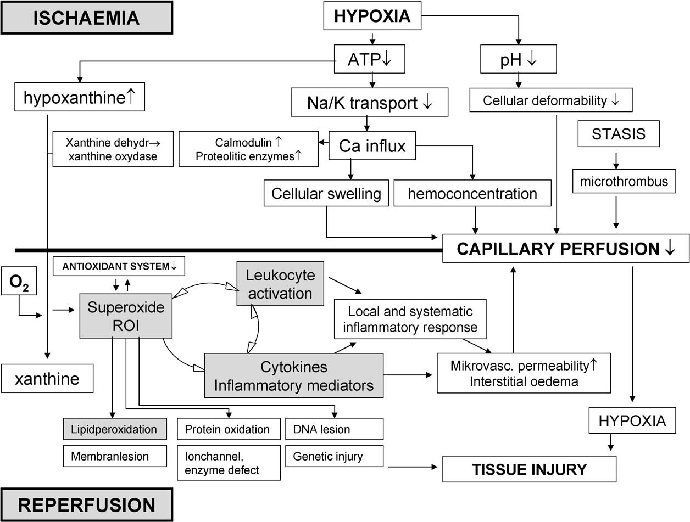
4. ROS
Parks DA, Granger DN. Ischemia-induced vascular changes: role of xanthine oxidase and hydroxyl radicals. Am J Physiol 1983;245(2):G285e9

Slide 31
5. Phosphate
Patients undergoing abdominal aortic surgery will demonstrate significant hypophosphatemia postoperatively, in particular 48 h after the end of the procedure.
This might in part be explained by an increase in phosphate compound synthesis after restoration of blood flow, leading to a shift in phosphate from the extracellular to the intracellular compartment.
Andersen PT, Nielsen LK, Moller-Petersen J, et al. Severe hypophosphatemia following elective abdominal aortic bypass grafting. Acta Chir Scand 1987;153(11e12):641e6.

Slide 32
6. Prostaglandins, platelets, neutrophils, and complement system
Prostaglandin and thromboxane concentrations are elevated during aortic surgery. Prostacyclin is released even before the application of the aortic cross-clamp due to mesenteric manipulation, while thromboxane concentration in the plasma increases after clamping of the aorta.
Release of thromboxane in particular to a decrease in cardiac contractility during aortic clamping . Aspirin may attenuate these cardiodepressive effects.
Lymphocyte counts decrease, while leukocyte and neutrophil counts increase after unclamping of the aorta in patients undergoing aortobifemoral bypass surgery.
During abdominal aortic surgery, an increase in the concentrations of anaphylatoxins C3a and C5a has been observed in particular during the time of aortic cross-clamping.
The increase in the concentrations of these anaphylatoxins lead to an increase in the mean airway pressure, pulmonaryartery pressure, and pulmonary vascular resistance . These anaphylatoxins can also cause cardiac dysfunction.
Seltzer JL, Goldberg ME, Larijani GE, et al. Prostacyclin mediation of vasodilation following mesenteric traction. Anesthesiology 1988;68(4):514e8.

Slide 33
7. Endotoxins, cytokines, and other mediators
During ischemia triggered by aortic clamping, endotoxins and cytokines such as TNF and Interleukin-6 are released. It is a common belief that the release of these substances plays a substantial role in the observed hemodynamic changes.
The temporary decrease or even full cessation of the blood flow to the intestines or the reperfusion upon the release of the cross-clamp may lead to an increase in intestinal permeability.
This increase is followed by an increase in the blood concentration of endotoxins, which by itself can trigger the release of interleukin-6 and other inflammatory mediators.
TNF has been associated with acute lung injury after acute intestinal ischemia and reperfusion.
Roumen RM, Frieling JT, van Tits HW, et al. Endotoxemia after major vascular operations. J Vasc Surg 1993;18(5):853e7.
Baigrie RJ, Lamont PM, Whiting S, et al. Portal endotoxin and cytokine responses during abdominal aortic surgery. Am J Surg 1993;166(3):248e51.

Slide 34
Effects of aortic cross-clamping on organ systems
1. Lungs
Following cross clamping- An increase in the pulmonary vascular resistance has been observed frequently. This might at least in part be explained by the increase in the blood volume circulating through the pulmonary vasculature that is associated with clamping of the thoracic aorta.
Pulmonary dysfunction after aortic clamping can also be attributed to the release of cells and compounds during reperfusion that are subsequently entrapped in the lungs.
Thromboxane and leukocyte may accumulate in the pulmonary tissue and, in combination with the increase in complement C3a and C5 activity after aortic clamping, lead to inflammatory processes and increase in microvascular permeability in the lungs, which can lead to noncardiogenic pulmonary edema.
TNF has also been associated with acute lung injury after acute intestinal ischemia and reperfusion.
Anner H, Kaufman Jr RP, Kobzik L, et al. Pulmonary hypertension and leukosequestration after lower torso ischemia. Ann Surg 1987;206(5):642e8.

Slide 35
2. KIDNEYS
Injury to the kidneys is observed quite frequently after surgery of the aorta that involves suprarenal and infrarenal aortic cross-clamping.
Cross-clamping the thoracic aorta leads to an 94% decrease in renal blood flow, glomerular filtration rate, and urine output. In patients undergoing procedures requiring suprarenal clamping, the incidence of transient postoperative renal dysfunction is 35%, while infrarenal clamping has an incidence of 10%
Renal failure requiring at least transient if not permanent dialysis is as frequent in suprarenal as it is during infrarenal cross-clamping with an incidence of 3% and 2%, respectively.
The etiology of renal failure after aortic surgery is almost always acute tubular necrosis induced by an ischemia-reperfusion insult associated with aortic cross-clamping.
In the kidneys,both oxygen delivery and renal cortical oxygenation remained low. This indicates that the kidneys in particular respond differently to ischemia and reperfusion and that oxygen deprivation may continue despite reinstitution of the blood flow.
The renineangiotensin system affects the renal blood flow during aortic clamping. Mainly, angiotensin II will increase the renal vascular resistance and sodium absorption directly by causing constriction of the vas afferens and indirectly by increasing aldosterone production.
Myers BD, Miller DC, Mehigan JT, et al. Nature of the renal injury following total renal ischemia in man. J Clin Invest 1984; 73(2):329e41.

Slide 36
Intraoperative Renal Protection
Aortic cross-clamping, including furosemide, mannitol, dopamine, and acetylcysteine;
Fenoldopam, a selective dopamine receptor antagonist, was thought to hold promise for renal protection based on its ability to augment renal blood flow in normotensive human volunteers.
Selective renal perfusion using cold hyperosmolar crystalloid, histidine–tryptophan–ketoglutarate (HTK) solution, or saline with mannitol and methylprednisolone have been associated with improved renal outcomes following the repair of juxtarenal AAA requiring suprarenal clamping.

Slide 37
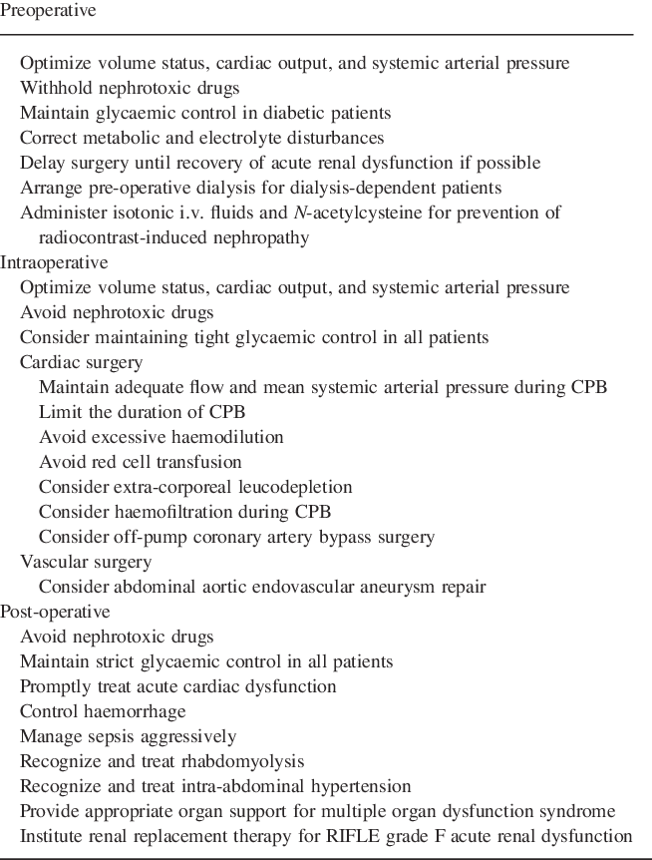
Renal protection strategies

Slide 38
3. Spinal cord
The blood flow to the spinal cord may be compromised during surgery involving the descending aorta. During the time of aortic cross-clamping, the spinalcord perfusion relies on collateral blood flow.
The artery of Adamkewicz is one of the most distal feeding arteries to the spinal cord, and if this artery derives from that part of the aorta affected by the placement of the cross-clamp or repair itself, then the spinal cord is at the greatest risk for ischemia.
Like other organs affected by aortic cross-clamping, the degree of injury inflicted on the spinal cord correlates with the duration of the limited blood flow.
RS A. The effects of blood flow and anoxia on spinal cardiovascular centers. Am J Physiol 1945;143(143):698e708.

Slide 39
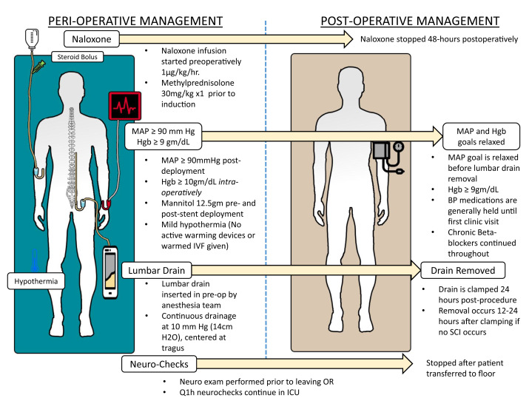
Neuro protection strategies
Spinal ischemia common in
  Thoracic > supraceliac > infrarenal
  Aortic clamp time >60min
  Hypotension
  Emergency procedures
  Recurrent aortic aneurysm surgery

Slide 40
4. Intestine
Depending on the location of aortic cross-clamping, the intestine may be at risk for ischemic injury. In particular, supramesenteric/supraceliac cross-clamping can lead to a significant reduction in blood flow to the gut.
As part of the open aortic aneurysm repair, the inferior mesenteric artery (IMA) and the hypogastric artery are often sacrificed , putting the patient at risk of developing colorectal ischemia. The incidence of colorectal ischemia is 4.5% during elective cases and up to 17% during emergent open aortic repairs.
The severity can range from ulcerations and superficial necrosis to transmural gangrene of the colon and rectum. Perioperative mortality of colorectal ischemia can be as high as 31% .
Intestinal tonometry measuring intraluminal PCO2 as a surrogate of mucosal CO2 is a reliable predictor for the occurrence of intestinal ischemia and can be used intraoperatively.
Furthermore, temporary interruption of the blood flow to the gut puts the intestine at risk of developing ischemia-reperfusion injury, thus contributing to the overall inflammatory processes that occur after aortic cross-clamping.
Bast TJ, van der Biezen JJ, Scherpenisse J, et al. Ischaemic disease of the colon and rectum after surgery for abdominal aortic aneurysm: a prospective study of the incidence and risk factors. Eur J Vasc Surg 1990;4(3):253e7.

Slide 41
SIRS
Systemic inflammatory response is considered to be the precursor of morbidity and mortality after open repair.
The inflammatory response is higher in patients presenting for RAAA repair compared to patients presenting for elective AAA repair and the levels of inflammatory mediators correlate with the development of acute respiratory distress syndrome and multiorgan failure (MOF).
Operative mortality following ruptured AAA repair may be divided into early and late deaths. The most frequent cause of early death is hemorrhagic shock while up to 90% of deaths after 24 h are caused by MOF.
SIRS arises from the response to extensive surgical trauma, the release of vasoactive agents due to bowel manipulation and mesenteric traction, response to graft material, intestinal ischemia from intraoperative hypotension, aortic clamping and ligation of inferior mesenteric artery, ischemia-reperfusion injury, blood transfusions, which alter cytokine production, and cytokines released from the mural thrombus.

Slide 42
SIRS
Endotoxin, which has been implicated as the trigger for the inflammatory response, can be released directly from bowel ischemia-reperfusion or indirectly through the release of inflammatory mediators after lower limb reperfusion.
The clinically significant cytokines that are released include TNF-α, IL-1β, IL-6, and neutrophil CB 11b. IL-1β is a locally acting cytokine, which acts as a pyrogen, induces hypotension, activates and promotes leukocyte adherence, induces acute phase protein synthesis, and stimulates the secretion of IL-6.
Increased IL-6 is the most consistent response to aortic surgery. It enables the neutrophils to release TNF-α and neutrophil CD11b, which, along with IL-6, have been implicated as mediators of SIRS and MOF.
Excessive manipulation in AAAs with intramural thrombi can lead to a clinical response similar to SIRS that is not seen in patients with small or no mural thrombi.
Gadaleta D, Fantini GA, Silane MF, et al. Neutrophil leukotriene generation and pulmonary dysfunction after abdominal aortic aneurysm repair. Surgery 1994;116(5):847e52. [28] Caty MG, Guice KS, Oldham KT, et al. Evidence for tumor necrosis factor-induced pulmonary microvascular injury after intestinal ischemia-reperfusion injury. Ann Surg 1990;212(6):694e700.

Slide 43
SUMMARY
The temporary occlusion of the aorta and the subsequent reinstitution of blood flow to previously ischemic areas are the most critical steps during open aortic repair.
The occlusion of the aorta will increase afterload and arterial blood pressure.
Cross-clamping of the supraceliac aorta leads to blood volume shifts resulting in an increase in preload and cardiac output.
Clamping of the infraceliac aorta leads to less predictable shifts in blood volume and changes in cardiac output.

Slide 44
SUMMARY
During aortic cross clamping, many vasoactive substances and mediators are released further altering blood flow and hemodynamic parameters.
Release of the aortic cross-clamp is followed by shifts in blood volume as well as the release of vasodilating substances such as lactate, adenosine, and CO2, leading to central hypovolemia and hypotension.
Reinstitution of blood flow after unclamping also triggers an ischemia reperfusion response.
The complex hemodynamic, humoral and inflammatory changes occurring during aortic clamping and after unclamping of the aorta can ultimate contribute to frequently observed postoperative complications like pulmonary dysfunction and acute kidney injury.

Slide 45
Take home message
To avoid overloading the heart during aortic clamping, fluid administration before aortic clamping should be kept to a minimum.
Blood pressure during aortic clamping should be kept as high as the heart can tolerate to maintain collateral perfusion to areas distal to the aortic cross-clamp.
To attenuate hypotension after unclamping, the clamp should be removed slowly from the aortic cross-clamp.
A fluid bolus and vasopressors should be administered as well.
Slow and gradual removal of the aortic cross-clamp and reperfusion with normo-oxygenated rather than hyper-oxygenated blood may help reduce the severity of ischemia-reperfusion injury.

Slide 46
Postoperative management
Routine ICU care
Ventilation strategy
ABG management
Temperature control
Anemia correction
Coagulation correction
Assess for need of dialysis
Pain management

Slide 47
COMPLICATIONS
Renal dysfunction / Renal failure
MI
RESPIRATORY COMPLICATIONS
Coagulopathy / DIC
Visceral ischemia
Spinal cord ischemia
Lower limb ischemia
Anastomotic bleed
Aorto Enteric Fistula
MTP – Related complications
ACS

Slide 48
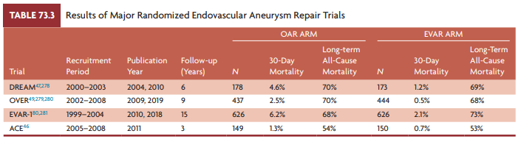

Slide 49
THANK YOU

