Slide 1
Diagnosis & Risk stratification venous thromboembolism
Dr. Siddharth

Slide 2
Epidemiology and burden of the disease
The annual incidence of first episode of symptomatic DVT in the adult population ranges from 50 to 100 per 100 000 population[1]
overall incidence of venous thromboembolism (VTE) around 25% higher with the addition of pulmonary embolism (PE) events.[2]
The incidence of DVT is slightly greater in women aged 20 e 45 years, but men have a higher incidence between 45 and 60 years of age
1. Heit JA, Spencer FA, White RH. The epidemiology of venous thromboembolism. J Thromb Thrombolysis 2016;41:3e14.
2. Spencer FA, Emery C, Joffe SW, Pacifico L, Lessard D, Reed G, et al. Incidence rates, clinical profile, and outcomes of patients with venous thromboembolism. The Worcester VTE study. J Thromb Thrombolysis 2009;28:401e9

Slide 3
Risk Factors
Systemic lupus erythematosus (SLE) and the lupus anticoagulant
Behçet syndrome
Homocystinuria
Polycythemia rubra vera
Thrombocytosis
Inherited disorders of coagulation/fibrinolysis
Antithrombin III deficiency
Protein C deficiency
Protein S deficiency
Prothrombin 20210A mutation
Factor V Leiden
Dysfibrinogenemias and disorders of
plasminogen activation
Intravenous (IV) drug abuse
Oral contraceptives
Estrogens
Heparin-induced thrombocytopenia (HIT)
Age
Immobilization longer than 3 days
Pregnancy and the postpartum period
Major surgery in previous 4 weeks
Long plane or car trips (> 4 hours) in previous 4 weeks
Cancer
Previous DVT
Stroke
Acute myocardial infarction (AMI)
Congestive heart failure (CHF)
Sepsis
Nephrotic syndrome
Ulcerative colitis
Multiple trauma
CNS/spinal cord injury
Burns
Lower extremity fractures
Notes:
In flower brackets : genetic conditions
Marked in red : A meta-analysis of studies evaluating individual clinical features of DVT showed that only a past history of DVT and malignant disease are useful for diagnosis, and no individual clinical feature is useful for ruling out DVT

Slide 4
Common risk factors
Presence of an acute infectious disease
Age older than 75 years
Cancer
History of prior VTE
Obesity
Surgery
Immobility.
Genetic thrombophilia is identified in 30% of patients with idiopathic venous thrombosis
Kakkos SK et al., European Society for Vascular Surgery (ESVS) 2021 Clinical Practice Guidelines on the Management of Venous Thrombosis, Eur J Vasc Endovasc Surg 2020, https://doi.org/10.1016/j.ejvs.2020.09.023
Notes:
More recently, prolonged computer related “seated immobility syndrome” has also been recognised as a potential risk factor.
The most common inherited risk factor is a non-O blood type, which is associated with double the risk of VTE.

Slide 5
Symptoms
Edema - Most specific symptom
Leg pain – most common .Occurs in 50% of patients but is nonspecific
Tenderness - Occurs in 75% of patients
Warmth or erythema of the skin over the area of thrombosis
Clinical symptoms of pulmonary embolism (PE) as the primary manifestation
Streiff, M. B., Agnelli, G., Connors, J. M., Crowther, M., Eichinger, S., Lopes, R., McBane, R. D., Moll, S., & Ansell, J. (2016). Guidance for the treatment of deep vein thrombosis and pulmonary embolism. Journal of thrombosis and thrombolysis, 41(1), 32–67. https://doi.org/10.1007/s11239-015-1317-0
Notes:
1. The most commonsymptom, calf pain, has been reported to have sensitivity between 75% and 91% and specificity between 3% and 87%.
2. in cancer patients, the negative predictive value of absence of swelling is as high as 97% for outpatients and 92% for inpatients.
Several lower extremity disorders may mimic DVT. These include lymphoedema, SVT, PTS, cellulitis, ruptured Baker cyst, and trauma

Slide 6
Signs
Calf pain on dorsiflexion of the foot with knee extended (Homans sign) present in 33% of pts with DVT, 50% of pts without DVT
A palpable, indurated, cordlike, tender subcutaneous venous segment (superficial phlebitis-40% have DVT)
Variable discoloration of the lower extremity
Blanched appearance of the leg because of edema (relatively rare)
Min SK, Kim YH, Joh JH, et al. Diagnosis and Treatment of Lower Extremity Deep Vein Thrombosis: Korean Practice Guidelines. Vasc Specialist Int. 2016;32(3):77-104. doi:10.5758/vsi.2016.32.3.77

Slide 7
Clinical suspicion :
Pts at risk
Symptoms
Pretest likelihood
Signs
Notes:
Several clinical features are known to be suggestive of DVT. These comprise symptoms, signs, and other clinical risk factors. Although useful to raise the clinical suspicion of DVT, these factors cannot be used individually to confirm or exclude the diagnosis. However, when incorporated in decision tools, an individualised pre-test probability of DVT can be assigned to patients, aiding decision making strategies.

Slide 8
Pre test probability-Well’s Criteria
Active cancer (any treatment within past 6 months) | 1 point
Calf swelling where affected calf circumference measures >3 cm more than the other calf (measured 10 cm below tibial tuberosity) | 1 point
Prominent superficial veins (non-varicose) | 1 point
Pitting oedema (confined to symptomatic leg) | 1 point
Swelling of entire leg | 1 point
Wells PS, Owen C, Doucette S, Fergusson D, Tran H. Does this patient have deep vein thrombosis? JAMA 2006;295:199e207.
Notes:
The most thoroughly studied and validated clinical decision score is the Wells DVT score

Slide 9
…contd……Well’s criteria
Localised pain along distribution of deep venous system | 1 point
Paralysis, paresis, or recent cast immobilisation of lower extremities | 1 point
Recent bed rest for >3 days or major surgery requiring regional or general anaesthetic within past 12 weeks | 1 point
Previous history of DVT or PE | 1 point
Alternative diagnosis at least as probable | Subtract 2 points

Slide 10
Well’s score
dichotomised Wells score
3 groups wells score
Wells' score is 2 or greater- DVT likely (40% risk).
Wells' score of <2 – DVT unlikely (<15% probability)
high likelihood of DVT if >3;
moderate likelihood if 1 to 2;
low likelihood if <0.
Wells PS, Owen C, Doucette S, Fergusson D, Tran H. Does this patient have deep vein thrombosis? JAMA 2006;295:199e207.
Notes:
The dichotomised Wells score is simpler and more widely used than the Wells three category version and significant advantages to stratification into three groups have not been demonstrated.
Although the Wells DVT score is useful, the probability of DVT in the low risk group has been reported to be as high as 5%.
With this risk of a false negative result, the score cannot be used as a standalone test to confirm or exclude DVT.

Slide 11


Diagnosis of DVT
- an algorithmic approach
Pretest Probability[wells score]
D Dimer
Venous US
Notes:
the score cannot be used as a standalone test to confirm or exclude DVT. However, when used in conjunction with additional investigations, namely D dimer measurements and/or ultrasound, it is a valuable tool for accurate decision making

Slide 12
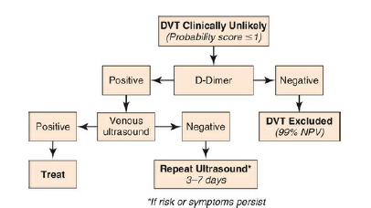
diagnostic algorithm for evaluation of symptomatic patients with low probability of deep venous thrombosis

Slide 13
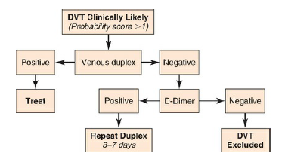
diagnostic algorithm for evaluation of symptomatic patients with high probability of deep venous thrombosis

Slide 14
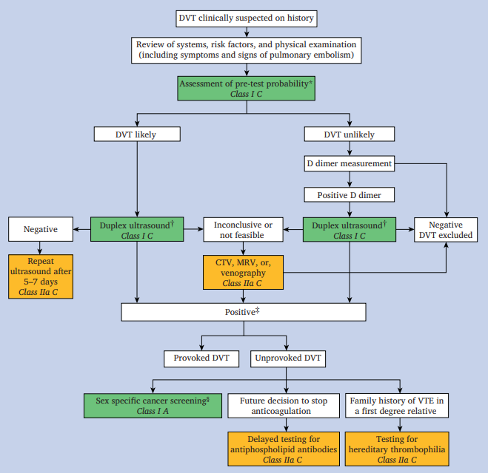
Notes:
Flowchart of recommendations[ESVS GUIDELINES 2021] for the diagnosis and investigation of deep vein thrombosis (DVT), including computed tomography venography (CTV) and magnetic resonance venography (MRV)
Clinical examination and sex specific screening is recommended rather than routine extensive screening for malignancy

Slide 15
Investigations :
In patients with low pretest probability of DVT or PE
-high-sensitivity D-dimer
In patients with intermediate to high pretest probability of lower-extremity DVT -US
In patients with intermediate or high pretest probability of PE, diagnostic imaging studies (eg, VQ scan, CT angiography)
Tests for thrombophilia when appropriate

Slide 16
D dimer measurement.
Sensitivity is approximately 95%, with a negative predictive value of 99% to 100%[1]
False negatives can still occur, particularly in patients treated with anticoagulants, with calf DVT or with symptoms lasting for longer than two to three weeks.[2]
D dimer testing is limited by its low specificity (35% to 55%).[1]
1. Stein PD, Hull RD, Patel KC, Olson RE, Ghali WA, Brant R, et al. D-dimer for the exclusion of acute venous thrombosis and pulmonary embolism: a systematic review. Ann Intern Med 2004;140:589e602.
2. Bernardi E, Camporese G. Diagnosis of deep-vein thrombosis. Thromb Res 2018;163:201e6
Notes:
D dimers are fibrin degradation products and are increased in any condition with increased fibrin formation, such as venous thrombosis
false positives are common as numerous other conditions yield increased D dimer levels, including infection, cancer, and pregnancy.
Older age is also associated with higher baseline D dimer concentrations and although age adjusted cutoffs have been introduced, the specificity remains low (51.1%).

Slide 17
Ultrasound
compression ultrasound scanning (CUS)
whole leg ultrasound scanning (WLUS)
quicker, simpler, has better reproducibility, and is readily available
it cannot detect distal (calf) DVT,
a negative CUS examination alone cannot exclude calf DVT, and rescanning may be required five to seven days later for confirmation
conclusive after one assessment, obviating the need for rescanning or additional examinations.
Also, detailed investigation of the whole leg may permit prompt identification of other pathological conditions.
Needleman L, Cronan JJ, Lilly MP, Merli GJ, Adhikari S, Hertzberg BS, et al. Ultrasound for lower extremity deep venous thrombosis: multidisciplinary recommendations from the Society of Radiologists in Ultrasound Consensus Conference. Circulation 2018;137:1505e15.
Notes:
Two distinct ultrasound assessment approaches are practised to investigate for DVT in symptomatic patients: two or three point compression ultrasound scanning (CUS) and whole leg ultrasound scanning (WLUS).
In CUS, deep vein patency is only assessed in two or three venous territories (usually the common femoral vein, the popliteal vein the femoral vein). Although the most proximal segments of the tibial veins can be interrogated during popliteal assessment, isolated calf DVT is not excluded by this technique.
However, WLUS provides a more extensive examination, where the entire deep vein network of the leg is scanned from the common femoral vein to the distal veins.

Slide 18
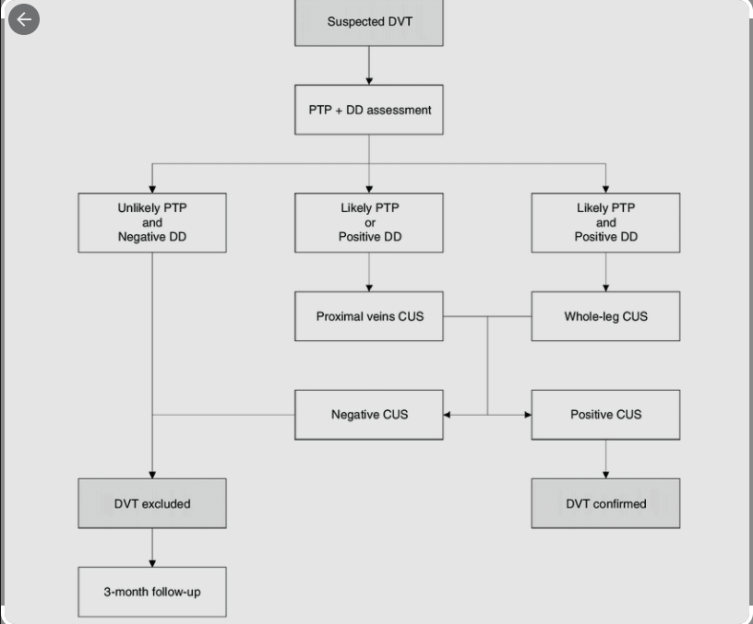
Ageno W, Camporese G, Riva N, Iotti M, Bucherini E, Righini M, Kamphuisen PW, Verhamme P, Douketis JD, Tonello C, Prandoni P; PALLADIO Study Investigators. Analysis of an algorithm incorporating limited and whole-leg assessment of the deep venous system in symptomatic outpatients with suspected deep-vein thrombosis (PALLADIO): a prospective, multicentre, cohort study. Lancet Haematol. 2015 Nov;2(11):e474-80. doi: 10.1016/S2352-3026(15)00190-8. Epub 2015 Oct 18. PMID: 26686257.
Notes:
therefore the GWC OF esvs is in favour of WLUS whenever there is clinical suspicion of calf DVT and WLUS is available.
Pre test probability :PTP
DD:Ddimer
Considering the differences between these techniques, the Palladio study proposed a comprehensive diagnostic algorithm for DVT, in which WLUS and CUS were used, depending on D dimer measurements and the pre-test probability of DVT.36 In this study, D dimer measurement and pretest probability assessment were performed on admission in the study population. On the basis of pre-test probability assessment, patients were stratified into three groups:
Group 1: pre-test probability unlikely and D dimer negative (DVT excluded)
Group 2: either pre-test probability for DVT likely or positive for D dimer (CUS only)
Group 3: pre-test probability for DVT likely and positive D dimer (WLUS)
However, this algorithm is not validated, and therefore the GWC is in favour of WLUS whenever there is clinical suspicion of calf DVT and WLUS is available.

Slide 19
Computed tomography venography
Effective technique for the diagnosis of proximal DVT in patients with suspected DVT and PE
With sensitivity and specificity comparable to ultrasound.
Ctv offers definite advantages over ultrasound.
Moreover, owing to its excellent spatial resolution, it may facilitate vessel measurement and case planning, when intervention is deemed necessary.
Ctv is expensive, requires the use of iodine contrast, and involves radiation exposure
Kakkos SK et al., European Society for Vascular Surgery (ESVS) 2021 Clinical Practice Guidelines on the Management of Venous Thrombosis, Eur J Vasc Endovasc Surg 2020, https://doi.org/10.1016/j.ejvs.2020.09.023
Notes:
1. Ctv offers definite advantages over ultrasound. when evaluating the pelvic veins or the inferior vena cava (ivc)
2. Can detect concurrent medical conditions that cause pain and swelling

Slide 20
Magnetic resonance venography
Role poorly described in the literature.
MRV to have equivalent sensitivity and specificity to ultrasound
Like CTV, MRV offers definite advantages over ultrasound
may help distinguish between acute recurrent thrombus and a persisting thrombus in the same location, with further implications for treatment regimens
Notes:
Can detect concurrent medical conditions that cause pain and swelling [extrinsic venous compression syndromes or incidental pelvic malignancies. ]
Recent studies have assessed the role of MRV in follow up after DVT, and differentiation between new and recurrent DVT. In fact, although duplex ultrasound cannot reliably determine the age of a thrombus and therefore distinguish acute recurrent DVT from persisting previous thrombus

Slide 21
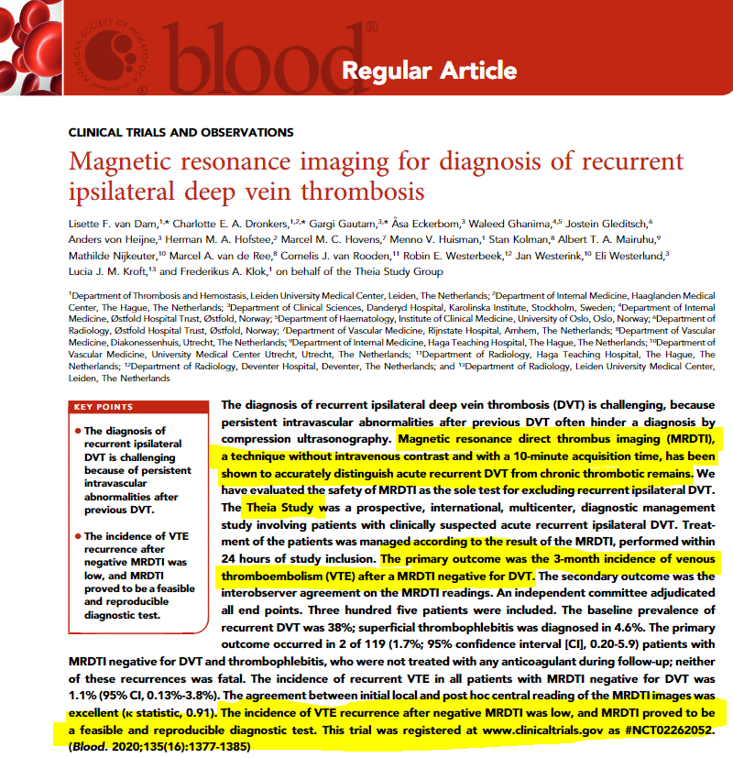
Notes:
In the Theia study, 119 patients with suspected recurrent DVT had magnetic resonance direct thrombus imaging negative for both DVT and SVT and were not treated with any anticoagulant during follow up.The three month incidence of recurrent symptomatic VTE was 1.7% (95% confidence interval [CI] 0.20% e 5.9%), suggesting that whenever recurrent ipsilateral DVT is suspected and a WLUS is inconclusive, magnetic resonance direct thrombus imaging should be considered for therapeutic management decisions.

Slide 22
Thank you

